Slide 2
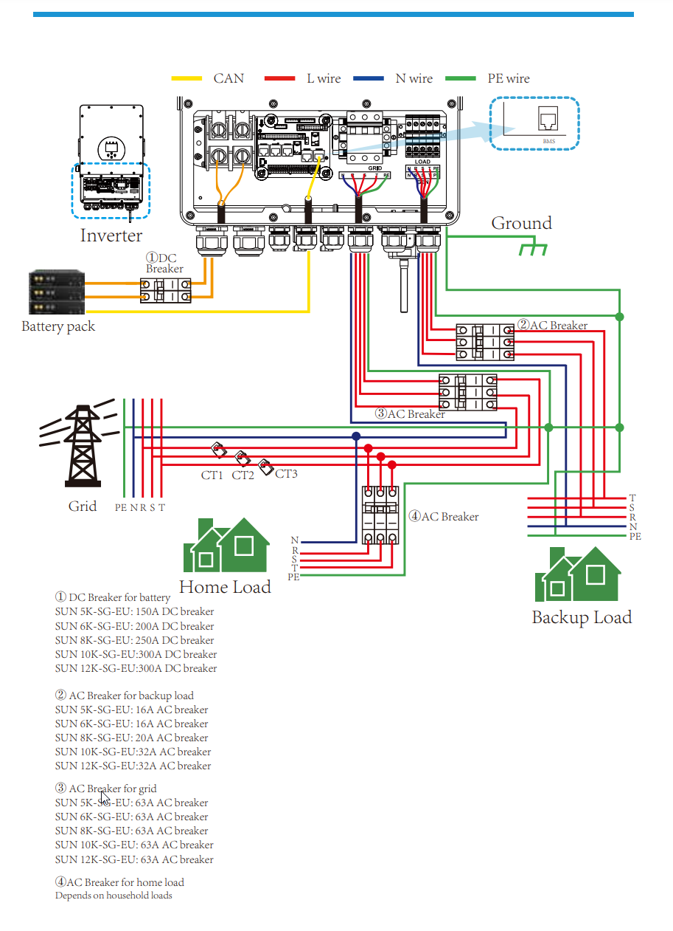
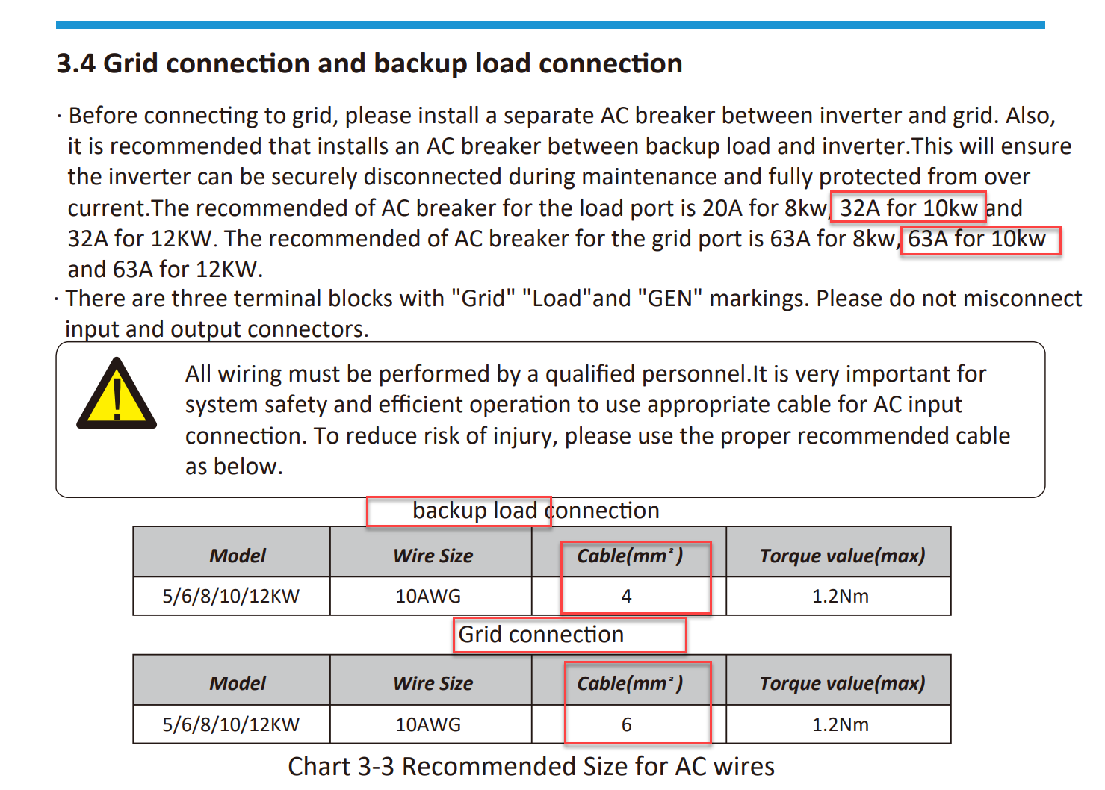
Deye information

Slide 3
Diagram – Germany TN-S Netz (AC-Seite)
RCD
N
R
S
T
AC Breaker
R
S
T
AC Breaker

Slide 4
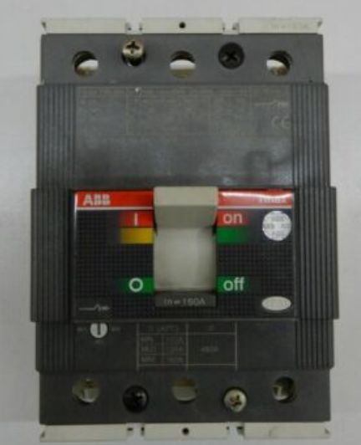
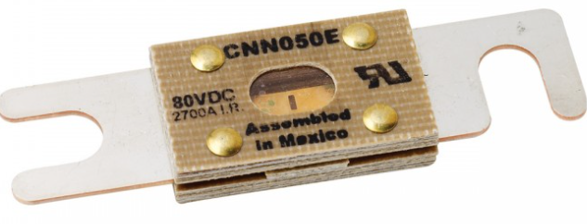
DC Seite
Deye 10K
RCD
PV String A
+
-
RCD
PV String B
+
-
DC Breaker ABB S804-PV-Z80
RCD
ABB SACE T3N LN250a
DC Busbar +
Battery 280a ANL 160A Fuse 16S1P
Battery 280a ANL 160A Fuse 16S1P
DC Busbar -
70mm²

Slide 5
DC Seite + AC Seite
32A C-Class
FI Typ A 30mA
16A B-Class
Backup Load
Deye 10K
R
R
+
Backup Load
S
S
PV String A
T
T
-
N
PV String B
+
-
DC Breaker ABB S804-PV-Z80
Sontheimer 63A 4Pol
16A B-Class
R
FI Typ A 30mA
R
Home Loads
S
S
ABB SACE T3N LN250a
T
T
N
32A C-Class
FI Typ A 300mA
SLS 63A
Grid
R
CT1
R
+
-
DC Busbar
Grid Port
S
CT2
S
T
CT3
T
N
Battery - 280a ANL FUSE 160a
32A C-Class
Micro-WR 230V AC
R
PE
GEN PORT
S
Battery - 280a ANL FUSE 160a
T
N
70mm²

Slide 6
DC Seite + AC Seite – Smart Load
32A C-Class
FI Typ A 30mA
16A B-Class
Backup Load
Deye 10K
R
R
+
Backup Load
S
S
PV String A
T
T
-
N
PV String B
+
-
32A C-Class
DC Breaker ABB S804-PV-Z80
R
Sontheimer 63A 4Pol
16A B-Class
R
FI Typ A 30mA
R
Home Loads
Smart Load (GEN Port)
S
S
S
T
T
ABB SACE T3N LN250a
T
N
32A C-Class
FI Typ A 300mA
SLS 63A
Grid
R
CT1
R
+
-
DC Busbar
Grid Port
S
CT2
S
T
CT3
T
N
Battery - 280a ANL FUSE 160a
PE
Battery - 280a ANL FUSE 160a
70mm²

Slide 7
DC Seite + AC Seite – Smart Load
32A C-Class
FI Typ A 30mA
16A B-Class
Backup Load
Deye 10K
R
R
+
Backup Load
S
S
PV String A
T
T
-
N
PV String B
+
-
32A C-Class
DC Breaker ABB S804-PV-Z80
R
Sontheimer 63A 4Pol
R
16A B-Class
S
FI Typ A 30mA
R
Home Loads
Smart Load (GEN Port)
S
S
T
T
ABB SACE T3N LN250a
T
N
32A C-Class
FI Typ A 300mA
SLS 63A
Grid
R
CT1
R
+
-
DC Busbar
Grid Port
S
CT2
S
T
CT3
T
N
Battery - 280a ANL FUSE 160a
PE
Battery - 280a ANL FUSE 160a
70mm²

Slide 8
DC Seite + AC Seite – Smart Load v1
32A C-Class
FI Typ A 30mA
16A B-Class
Backup Load
Deye 10K
R
R
+
Backup Load
S
S
PV String A
T
T
-
N
PV String B
+
-
32A C-Class
R
Sontheimer 63A 4Pol
16A B-Class
DC Breaker ABB S804-PV-Z80
R
FI Typ B 300mA
FI Typ A 30mA
R
Home Loads
Smart Load (GEN Port)
S
S
S
T
T
ABB SACE T3N LN250a
T
N
32A C-Class
SLS 63A
Grid
R
CT1
R
+
-
DC Busbar
Grid Port
S
CT2
S
T
CT3
T
N
Battery - 280a ANL FUSE 160a
PE
Battery - 280a ANL FUSE 160a
70mm²

